Slide 1



Data Analytics

Slide 2


Today's agenda
We’ll give a synopsis of the complete project in order to give a high-level understanding of the business problem we are discussing and the specific requirements.
Project Recap
We’ll go into the specific problem that the Data Analytics team has been focusing on and give some background on why this is such a big problem.
Problem
The Analytics Team
I’ll first give a brief overview of the problem and then go over our team’s responsibilities for this task.
In order for you to completely understand how we handle assignments of this kind, I will then go over the broad procedures we used when working on this assignment.
Process
Insights & Summary
In conclusion, I will go over all of the important discoveries and provide them as a compilation of insights and examples.

Slide 3

“Social Buzz” is a unicorn in the tech industry that is growing quickly and needs to adapt quickly to its worldwide reach.
Accenture has started working on the following activities during a three-month POC:
An examination of Social Buzz’s use of big data.
Strategies for a prosperous Initial Public Offering (IPO).
An examination to determine the top 5 content categories on Social Buzz.
Project Recap

Slide 4

Problem
In recent years, the customer has grown to an enormous extent, and they lack the internal resources to manage it.
Every day, Social Buzz receives over 100,000 posts, totaling 36,500,000 posts annually. Since all of the content is unstructured, it might be challenging to make sense of it all.
Determine the specifications that must be fulfilled for this project.
Combining tables from the sample data set.
An analysis of their content categories that identifies the Top – 5 with the highest total popularity.

Slide 5

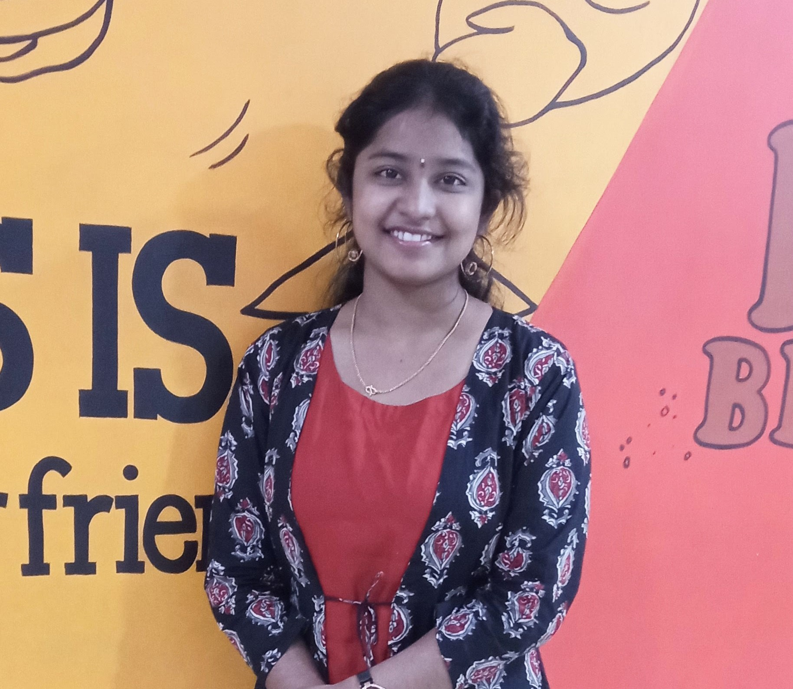
B. Venkata Krishna Data Engineer
The Analytics team
B. Monika Sai Data Analyst

Slide 6
Understanding Data
Process
1
2
Data Cleaning
Data Modelling
3
Data Analysis
4
5
Uncover Insights

Slide 7

Insights
Category with Highest Score
Animals
Month with Most Posts
Unique Categories
16
68K
JAN

Slide 10

ANALYSIS
Animals and science are two of the most popular content categories, this shows that people enjoy ‘real-life’ and factual content the most. So I would recommend that you keep creating more contents relating to those categories.
INSIGHT
Summary
Food is a common theme with the top 5 categories with ‘Healthy Eating’ ranking as one of the highest. This may give an insight to create a campaign and work with healthy eating brands to boost user engagement.
NEXT STEPS
It should come as no surprise that technology content is among the top categories gives the advancement of technology. It indicate that users like your technological material. Working with some of the biggest digital companies in the world is something I would suggest doing because it would undoubtedly increase user engagement.

Slide 11
Thank you!
ANY QUESTIONS?

